Slide 2
Internet Security
Bezpieczeństwo w intrenecie

Slide 3
Remember! YOU AREN'T ANYMOUS ON THE INTERNET!

Slide 4
DON'T WRITE DOWN YOUR PASSWORD

Slide 5
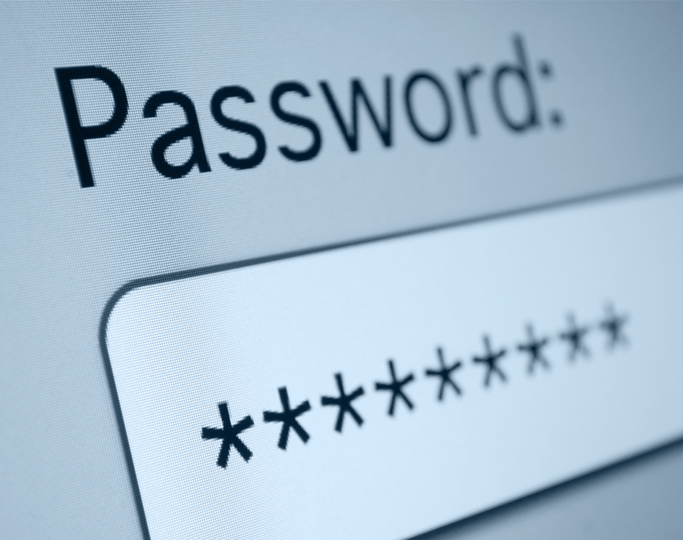
THINK UP A PASSWORD THAT YOU CAN EASILY REMEMBER

Slide 6
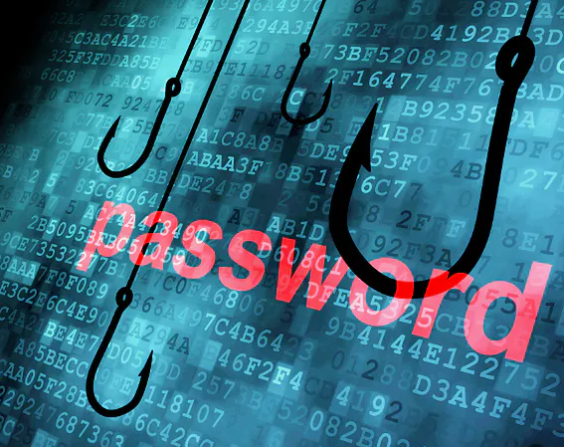
DON'T GIVE ANYONE YOUR PASSWORD

Slide 7
TO BE SAFER ON THE INTERNET YOU CAN USE ANTI-VIRUSES THEY WILL PROTECT YOU FROM VIRUSES AND HACKERS

Slide 8
DON'T INFORM UNTRUSTED PEOPLE THAT YOU ARE LEAVING HOME

Slide 9
DON'T ENTER YOUR PERSONAL DATA IN NICKNAMES

Slide 10
DON'T INFORM OTHERS ABOUT YOUR SOCIAL STATUS

Slide 11
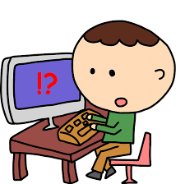
DON'T MEET WITH PERSONS WHICH YOU KNOW ON THE INTERNET

Slide 12
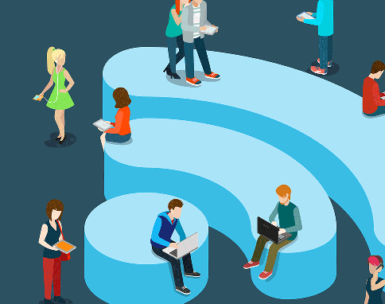
TRY TO AVOID THE USE OF PUBLIC NETWORKS

Slide 13
Remember! NOTHING DISAPPEAR IN INTERNET!

Slide 14
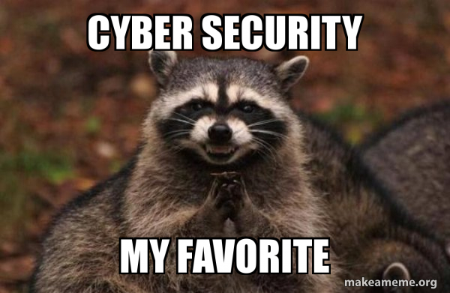
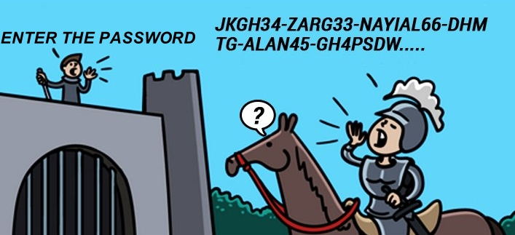
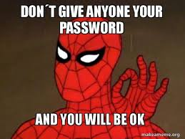
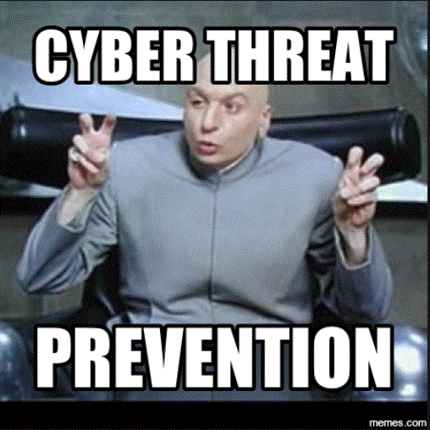
SOME MEMES

Slide 15
Made by: Adam Duda Tomasz Czubak Krzysztof Bieńkowski Piotr Gostyński Tymoteusz Klimczak
THANKS FOR YOUR ATTENTION :)

