Slide 1
INTERNET SECURITY
This is the advantage of the internet: everyone can have their say.
The disadvantage of the internet, however, is that anyonecan comment. - Myron Bolitar

Slide 2
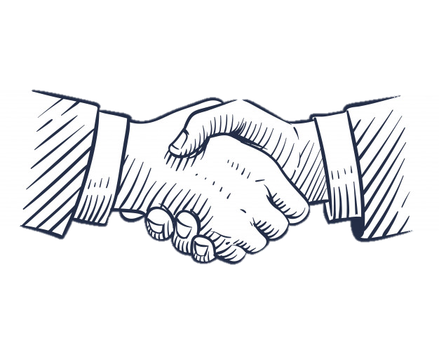
Obey the law on the internet
Remember that certain rules must also be followed on the Internet.

Slide 3
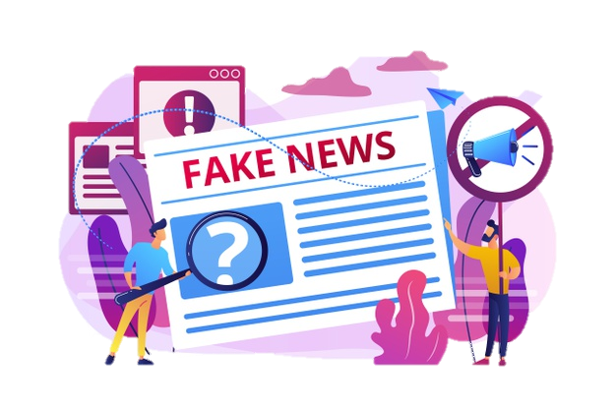
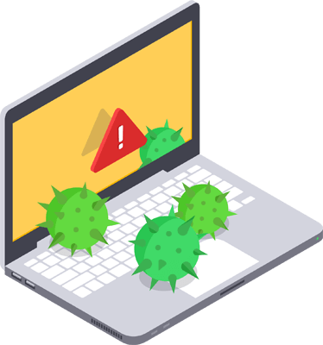
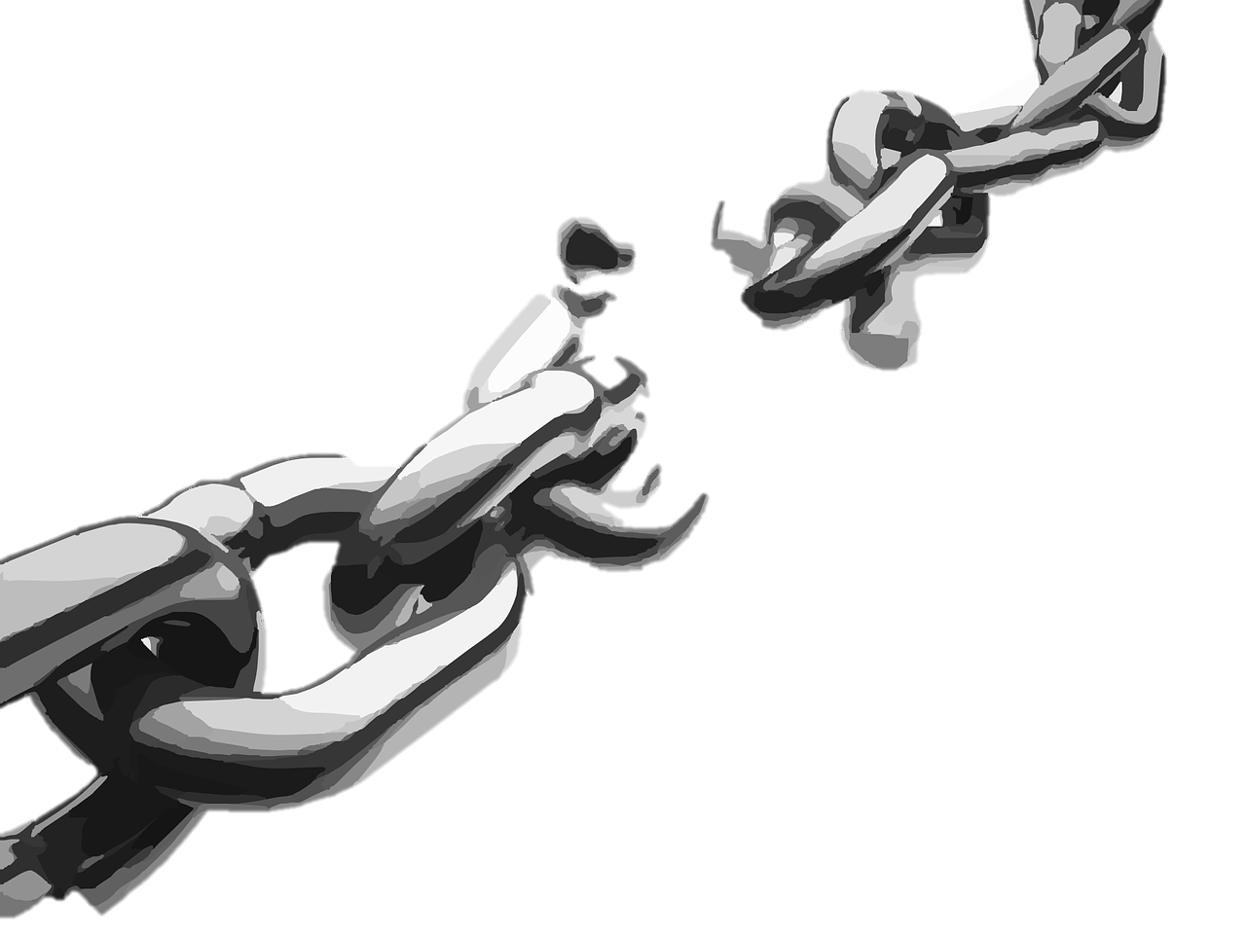
5 rules to follow on the Internet:
Do not insult other people
Respect copyright law
Do not post false information on the internet
Do not spread viruses
Do not send out spam or chains luck

Slide 4
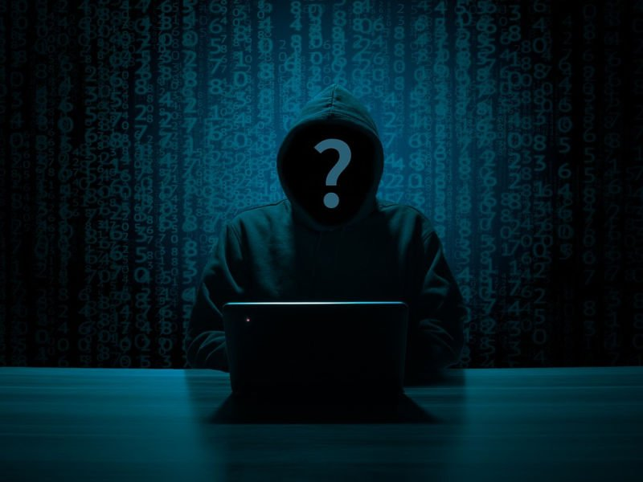
What dangers wait us on the internet ?
viruses
phishing
publicizing intimate information,photos and films
contact with violence and pornography
stealing money
stealing theft

Slide 5
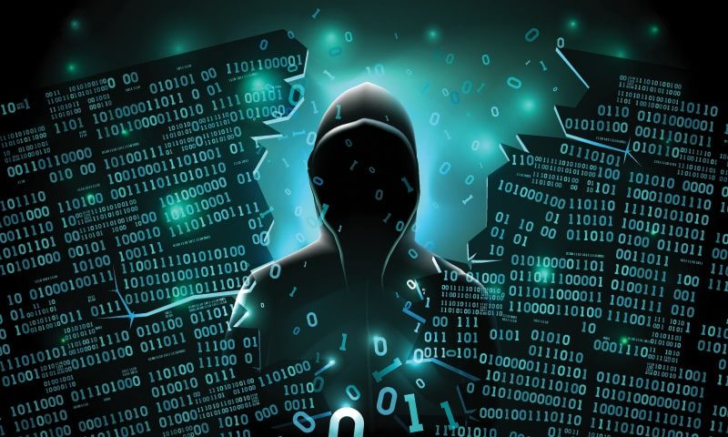
Hackers
Hacker - a person with very large, practical IT skills who identifies with the hacking community.
How to defend against them?
Password - the basis for safe operation in the network.
Don't ignore updates - these are often security fixes.
Protect your privacy - pay attention to what you post on social media.

Slide 6
Types of hacking / hackers
Get financial profits, which means stealing credit card numbers or defrauding banking systems.​
Gaining recognition and reputation in the hacker subculture.​
Corporate espionage, when hackers from
one company try to steal information about
a competitor's products and services to gain
a market advantage.​
A situation where entire nations engage
in state-sponsored hacking with the aim of economic theft.​
Four reasons why hackers hack computers and networks:

Slide 7
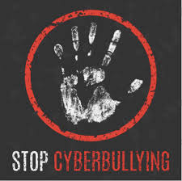
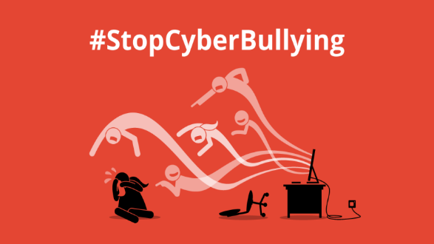
SAY STOP CYBERBULLYING!
What is the cyber-bulling?
In other words, cyber-bullying is violence using electronic media - primarily the Internet and mobile phones. This problem mainly affects children and adolescents. The activities referred to as cyber-bullying include, among others:
challenging, frightening, humiliating someone on the Internet or by telephone
taking photos or videos of someone without their consent
Photos, videos or texts that offend or ridicule someone
posting on the Internet or sending over the phone pimpersonating someone on the Web
While cyber-bullying may look innocent, it can do a lot of harm to your or your peers' mental health.

Slide 8
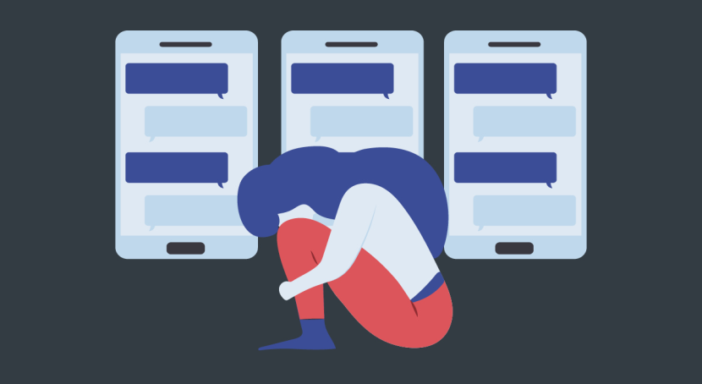
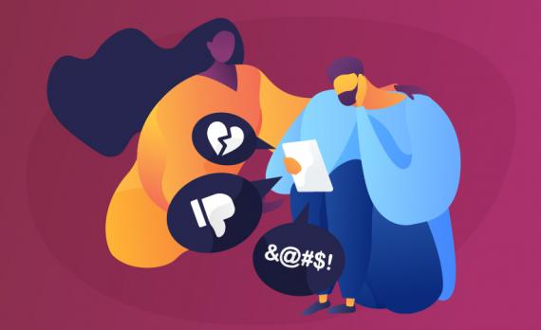
What to do when you are attacked by cyber-bullying on the Internet or you notice it being used
against another person:
------------------------------------------------------------------------------------------------------------------------
• First, when you notice aggression on the Internet against you or another person, you should secure evidence, prepare screenshots, and save messages.
------------------------------------------------------------------------------------------------------------------------
• Next, you must notify the site administrator about the fact of violence and try to block the account of the aggressive person.
------------------------------------------------------------------------------------------------------------------------
• If possible, try to contact the perpetrator by expecting him to end the violence and remove all remains from the network
------------------------------------------------------------------------------------------------------------------------
• If you are a victim of online violence, you should give support and attention.
------------------------------------------------------------------------------------------------------------------------
• If cyber-bullying begins to resemble a crime or a misdemeanor, you must inform the school or, as a last resort, the police
------------------------------------------------------------------------------------------------------------------------

Slide 9
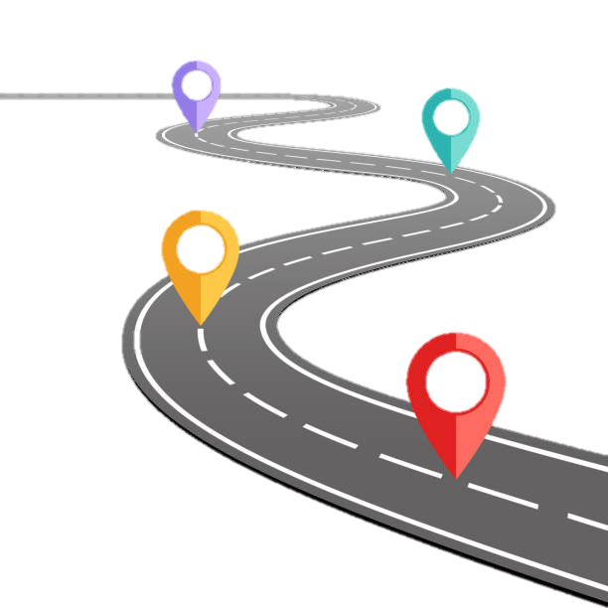
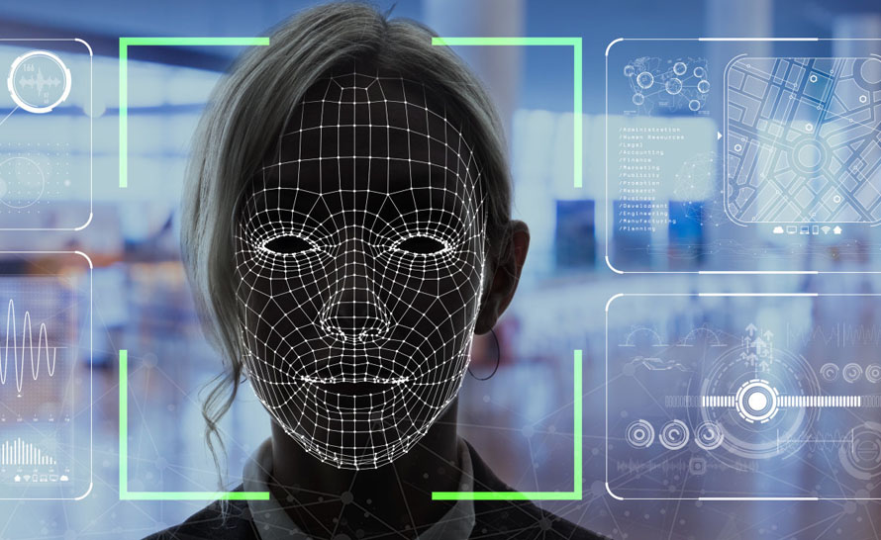
A COMPUTER VIRUS
A computer virus – a program or piece of code that infiltrates your computer without your knowledge or permission.
Where do they come from?
They're hidden in commonly used programs like games or PDF viewers
You can also get it in an infected file as an attachment to an e-mail
You yourself can download it along with another file from the Internet!
How to recognize a virus?
Your internet connection may be slow.
Your antivirus or firewall may be disabled.

Slide 10
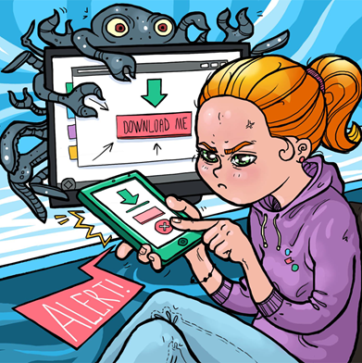
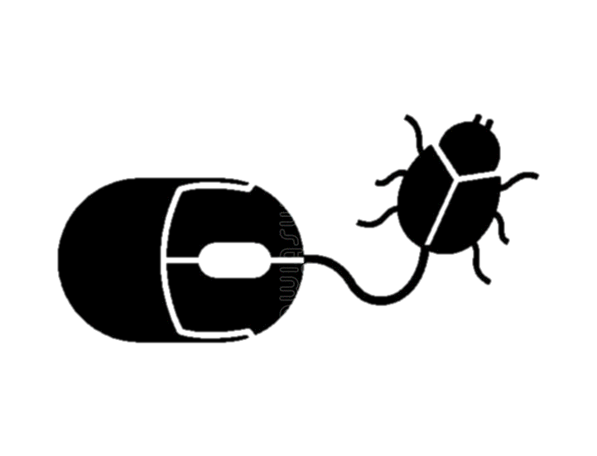
How to prevent viruses?
Secure your device with anti-virus programs -for example Avast Free Mobile Security.
Avoid programs from unknown sources.
Don't open attachments from unsolicited email or on Facebook.
Only download applications from the official shops Google Android stores.

Slide 11
How to protect yourself ?
Enter two-step sign-in
Don't enter your phone number, birthday, or address
Use antivirus
Don't use public Wi-Fi networks
Encrypt calls and emails Use HTTPS
Use secure search engines
Do not save passwords, pins, etc.

Slide 12
Rules-Save password
More than eight characters
Don't enter your data
A combination of uppercase and lowercase letters, numbers, and characters
Create a unique password each time
Don't save passwords
Have a different password for each device

Slide 13
What is this Internet search engine?
Internet search engine - a program or website intended for
the Internet user to search for information available on his resources.
The most popular Internet search:
Google
Bing
Yahoo
Ask
Yandex

Slide 14
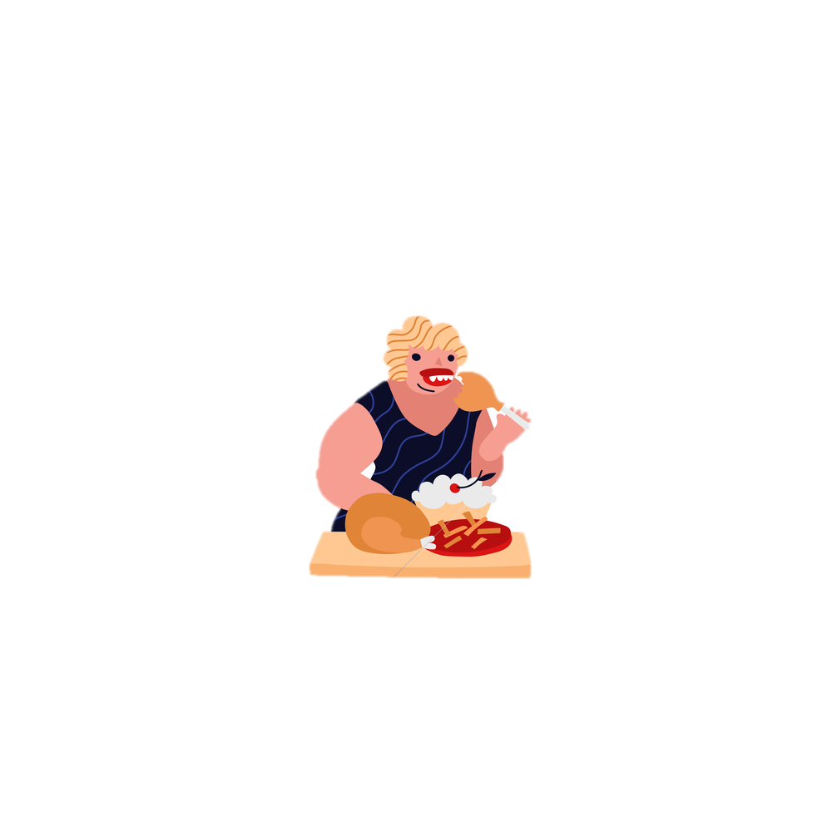
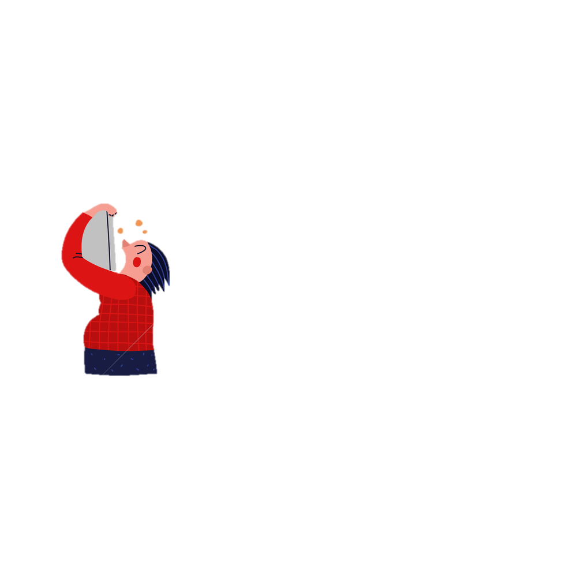
STEALING You take cookies from the store and you don’t pay.​
During family dinner, you eat with your hands.​
INSULITING You walk up to a stranger and say: you’re fool!​
LACK OF
CULTURE
THEFT You write homework from a friend without asking.​
COMPARISON SITE​ - be careful not to repeat this behavior on the Internet !
Stealing cookies is as punishable as stealing someone else's movie.

Slide 15
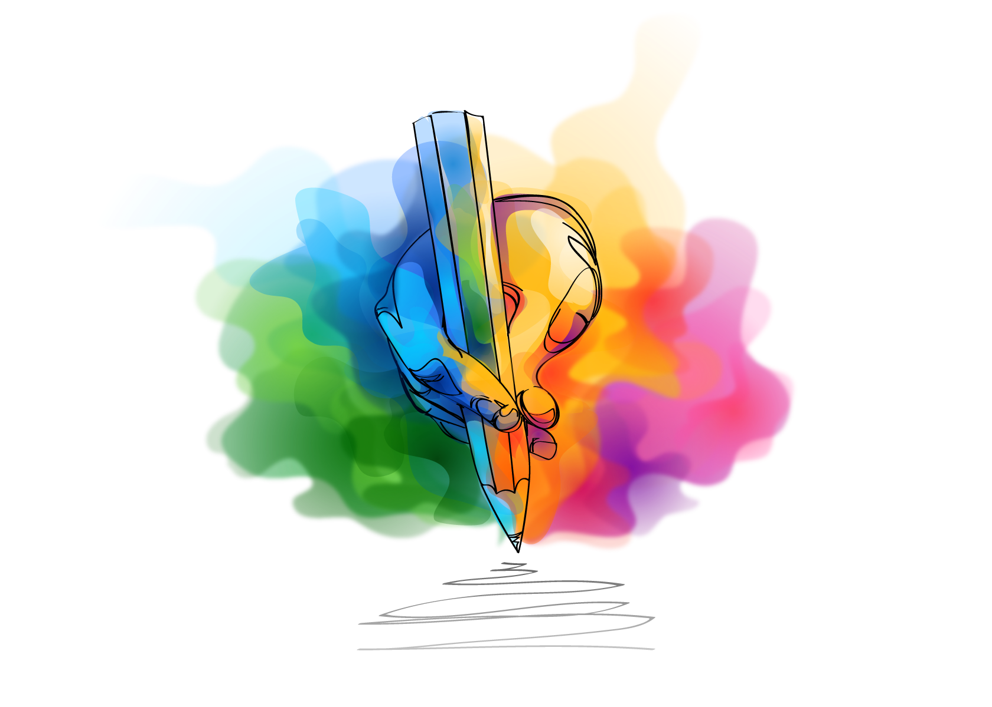
REMEMBER: BE CAREFULL WHAT POSTS YOU POST ON THE INTERNET
Inappropriate content you share will never disappear and may be used against you !!!

